Slide 1

Tech & Territory:
Software Salaries, Housing Markets, and Job Trends in U.S. Cities
Mitchel Carson
CS 3435 Data Collection and Data Visualization
Dr. Tinghao Feng
Appalachian State Computer Science
A Data-Driven Analysis Using Tableau

Slide 2
Where Do You Want to Live / Work as a Software Engineer?

Slide 3


Today’s Agenda
Explore the U.S. Software Developer Salaries Dataset
“How do software engineering salaries and job concentrations relate to housing affordability in US cities?”
How does home buying power vary across US cities, and what factors (salary levels, housing costs, and job density) are most influential in shaping this metric?
How do rental costs compare to median home prices in cities with high concentrations of software jobs, and what does this suggest about the trade-offs between renting and buying for software engineers?
“Which US cities offer the best value for software engineers when considering salary, housing costs, and rental expenses?”

Slide 4
The Dataset
This dataset provides an extensive look into the financial health of software developers in major cities and metropolitan areas around the United States.
We explore disparities between states and cities in terms of mean software developer salaries, median home prices, cost of living avgs, rent avgs, cost of living plus rent avgs and local purchasing power averages.
Through this data set we can gain insights on how to better understand which areas are more financially viable than others when seeking employment within the software development field.
Our data allows us to uncover patterns among certain geographic locations in order to identify other compelling financial opportunities that software developers may benefit from.
U.S. Software Developer Salaries
Analyzing Regional Variations
By Bruno Bonfrisco, Franco Seveso
https://www.kaggle.com/datasets/thedevastator/u-s-software-developer-salaries

Slide 5
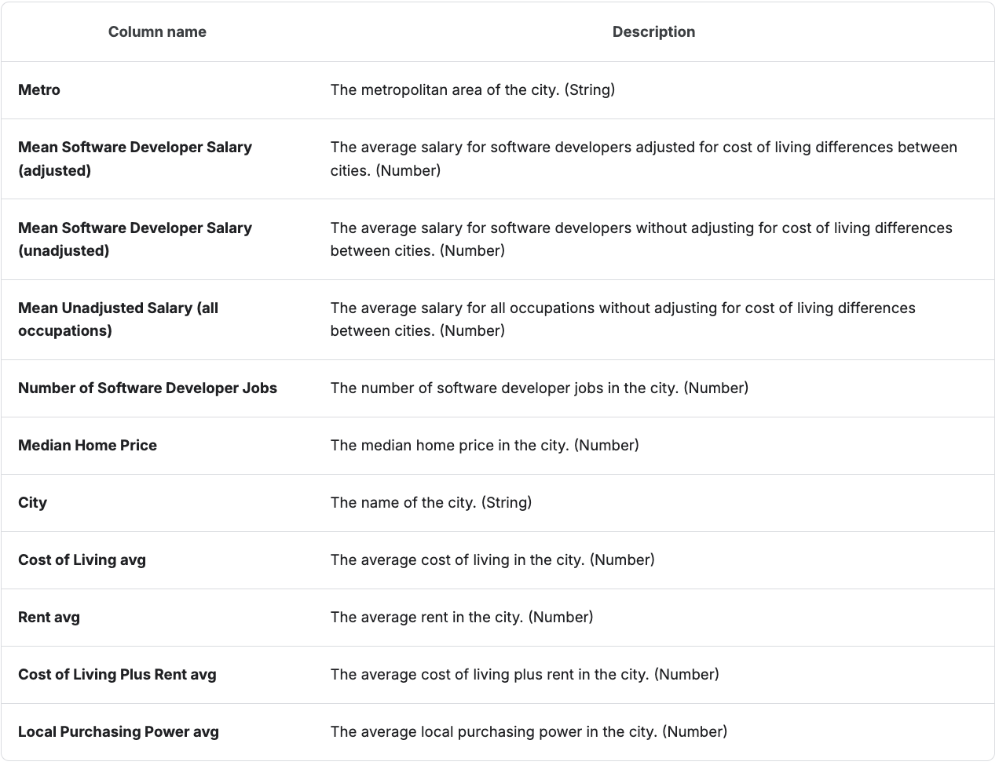
What are we looking at?

Slide 6


“How does home buying power vary across US cities, and what factors are most influential in shaping this metric?”
Notes:
Does it correlate with Mean Salary or Median Home Price? View bottom visualization and show that it is Median Home Price and Not Mean Salary.

Slide 7
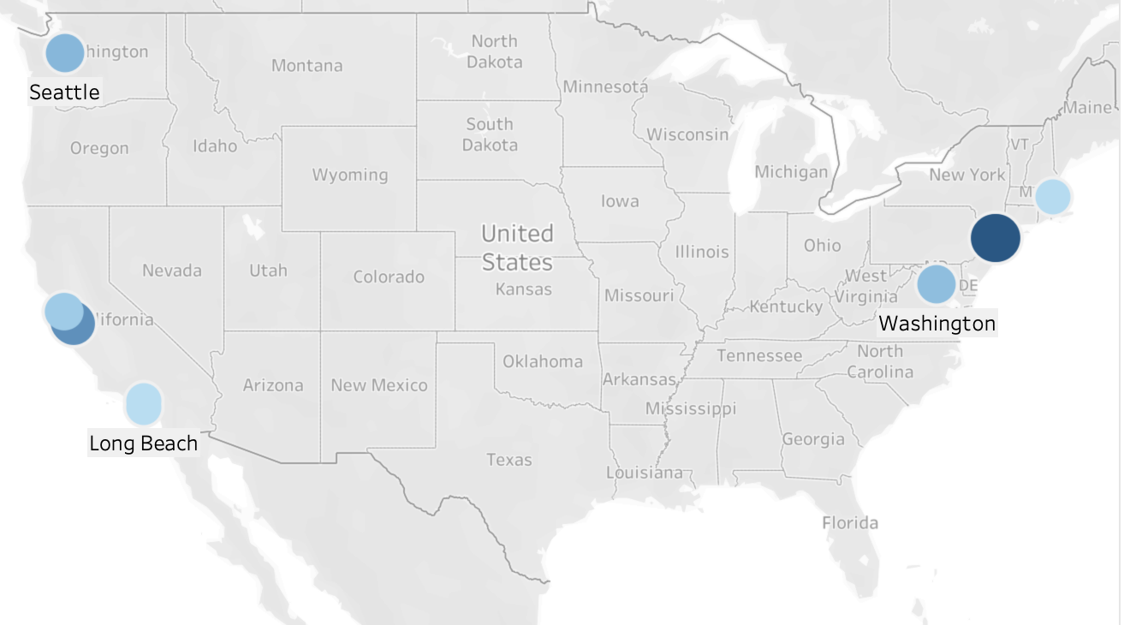
How do software engineering salaries and job concentrations relate to housing affordability in US cities?
Map: Cities with greater than 50, 000 SWE jobs

Slide 8
How do rental costs compare to median home prices in cities with high concentrations of software jobs, and what does this suggest about the trade-offs between renting and buying for software engineers?

Slide 9

Which US cities offer the best value for software engineers when considering salary, housing costs, and rental expenses?

Slide 10
Maintain a good GPA.
Prepare for technical interviews with Leetcode, CodingBat, Katiss, etc.
Learn the STAR technique for interview questions that test your social skills and teamwork abilities. (Companies don’t want to hire jerks.)
Create a LinkedIn profile and connect with at least 500 people.
Consistently display your coding practice and school assignments on Github.
Create a resume and get peer / professional feedback. ASU has a career center.
Apply for Internships / Full Time positions. ALOT. Not just 1 or 5.
Before you can become a full-time SWE you need to become a great candidate!

Slide 11
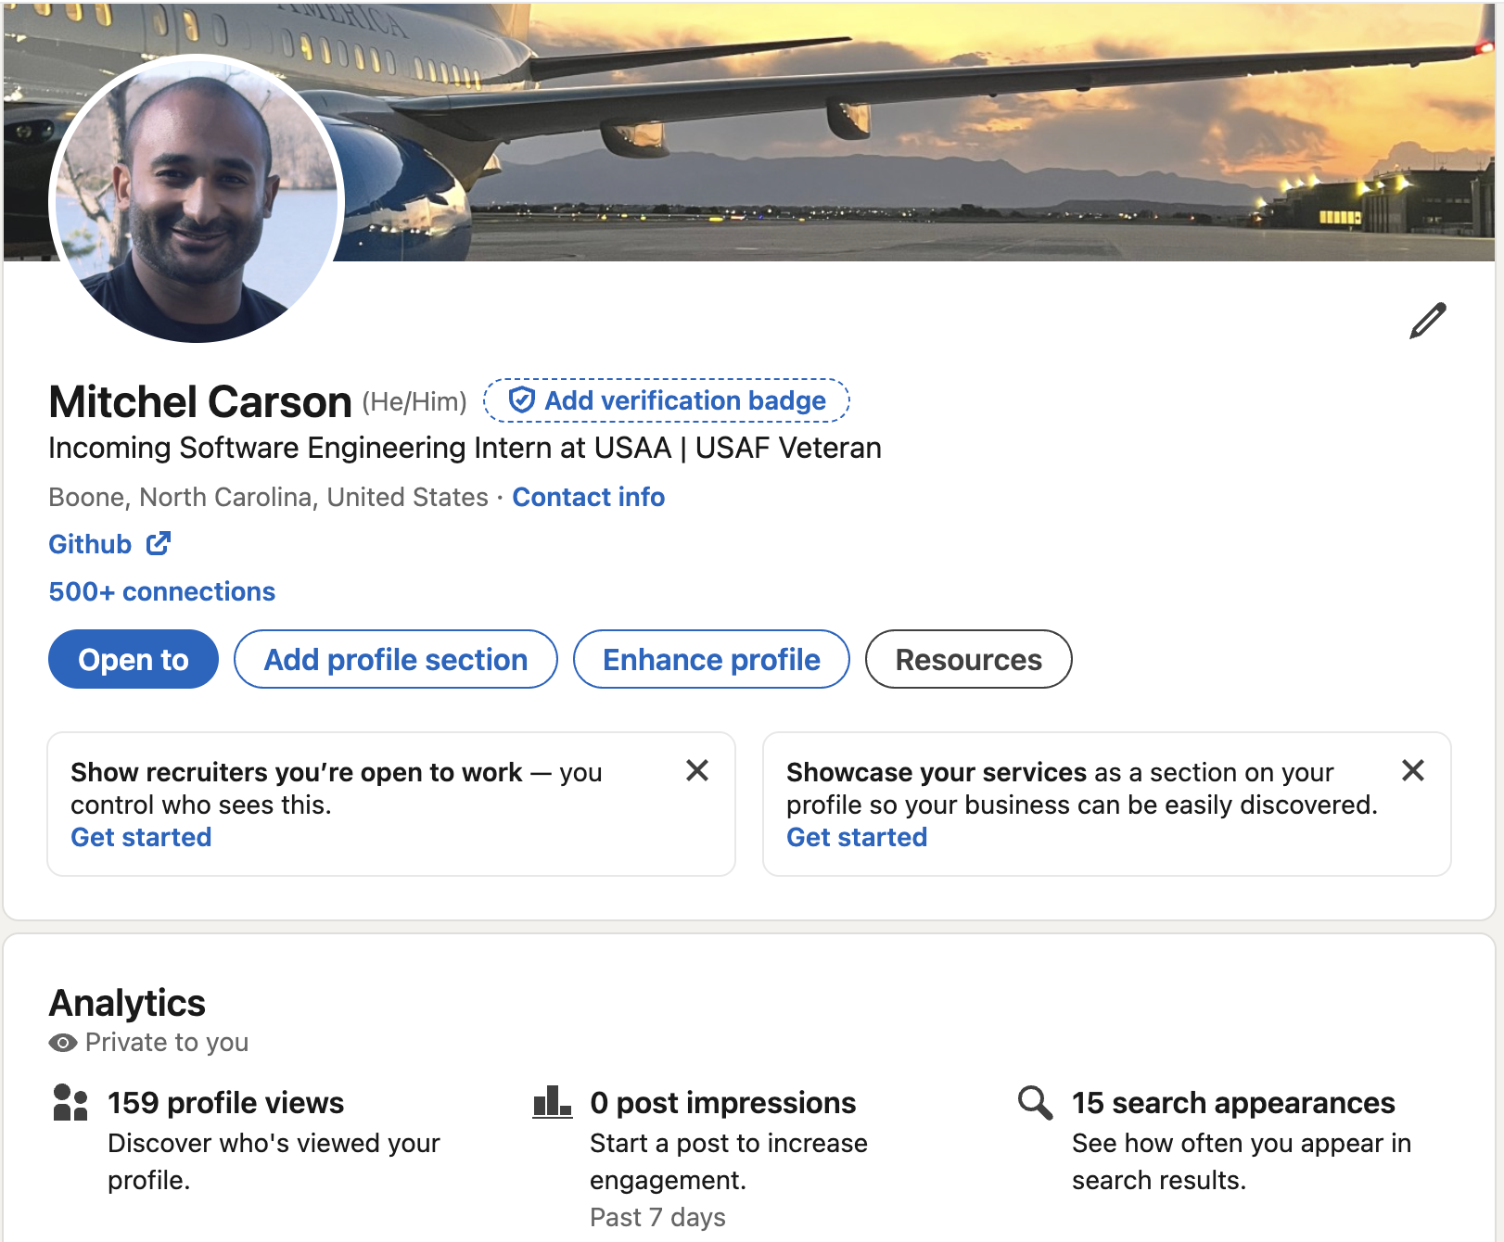
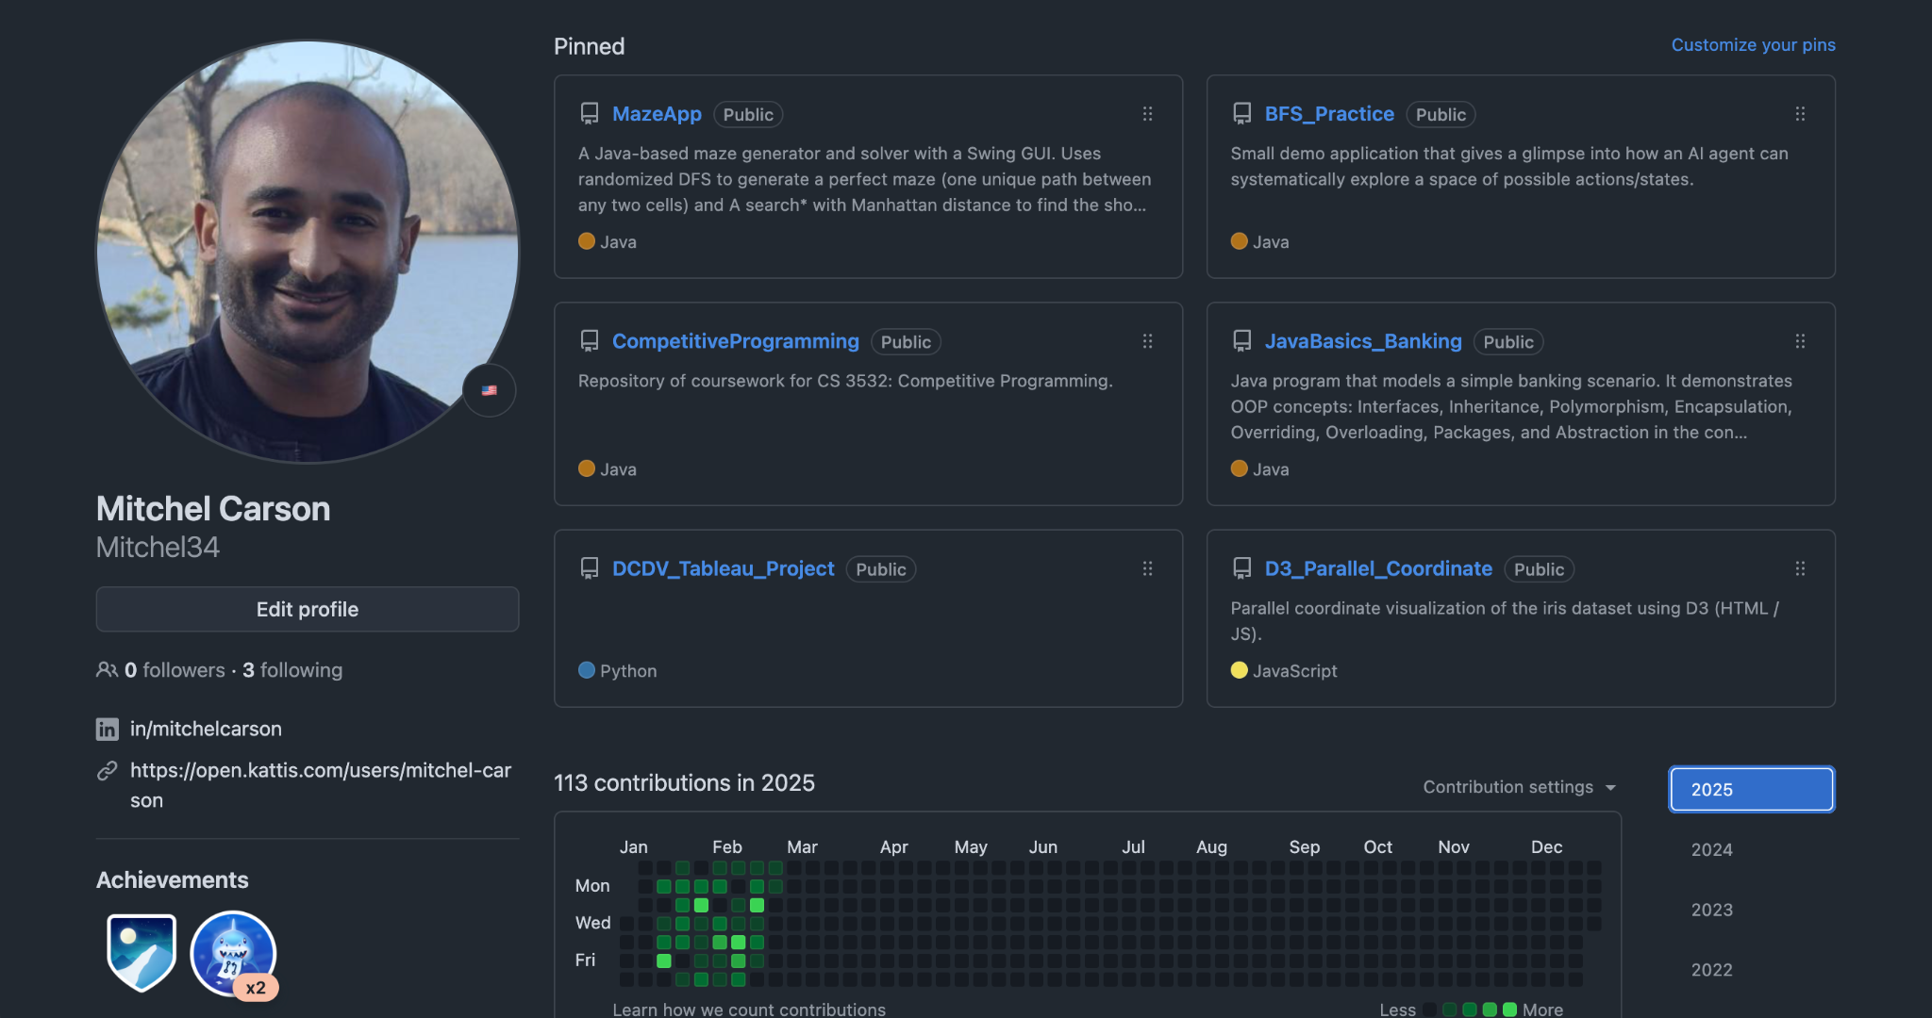
Any Questions?
https://www.linkedin.com/in/mitchelcarson/
https://github.com/Mitchel34

Slide 12




Let’s
Get
Employed!

